Slide 1



Conventional Machine Learning
20 May 2022 - Marc Galland, support data scientist, SILS
UvA Data Science Center “Data and Coffee”

Slide 2
Definition of Machine Learning
Machine Learning provides systems the ability to automatically learn and improve from experience without being explicitly programmed.
Machine Learning @ Vrije Universiteit van Amsterdam: https://mlvu.github.io/
Credit: Peter Bloem

Slide 3
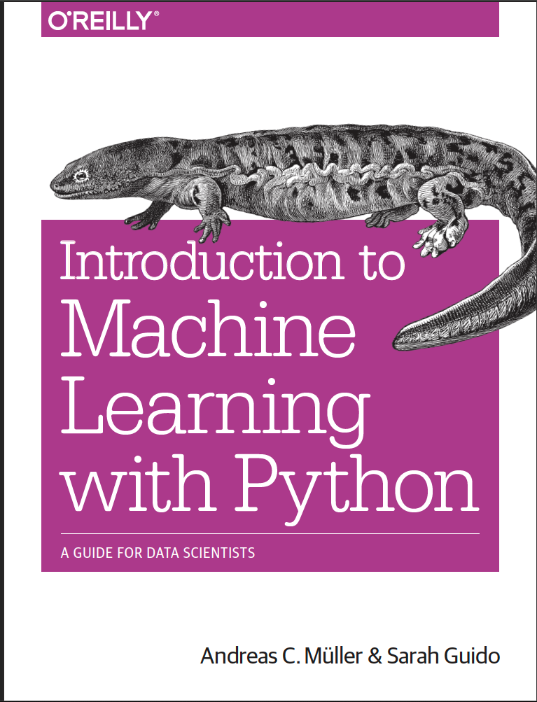
Introducing Machine Learning
“Extracting knowledge from data”
“[at the] intersection of statistics, artificial intelligence and computer science”
Main distinction:
Supervised learning: inputs with desired outputs
Is a tumor benign given input measurements?
Should a bank give a mortage given input data?
Unsupervised learning: only inputs

Slide 4
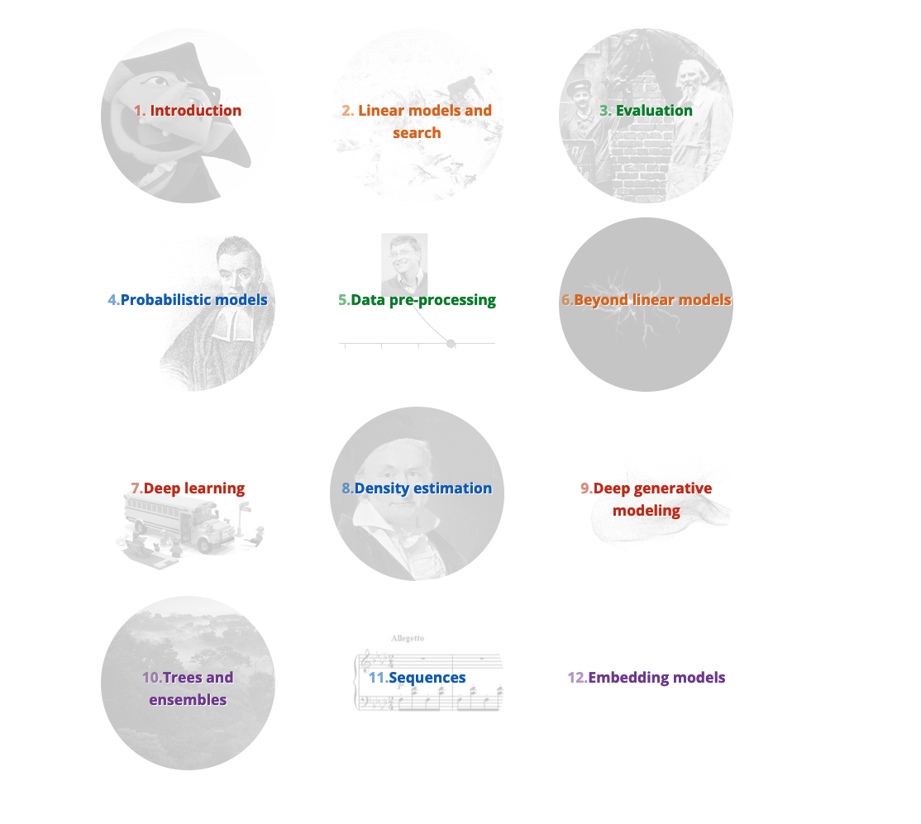
Machine Learning @ Vrije Universiteit van Amsterdam: https://mlvu.github.io/
Credit: Peter Bloem

Slide 5
Automated Machine Learning
Machine Learning for real people ☺
Applications of Machine Learning in Biology

Slide 6
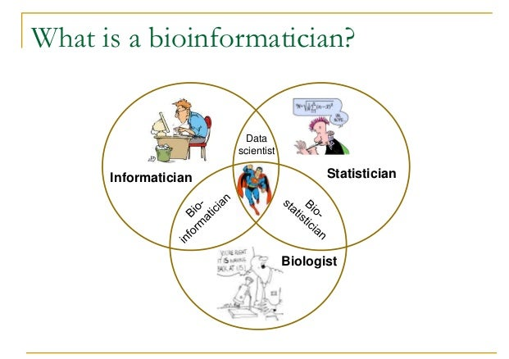
Who Am I?
Wet-lab Plant Biologist since 2009 (PhD)
Full-time Bioinformatician since 2014
Aspirant Data Scientist since 2017

Slide 7
Main issues for biologists related to data science

Slide 8
Main issues for biologists related to data science
Scientific programming
Learning Python often from scratch
Biologists often some command of R... but ML is not as developed compared to Python.

Slide 9
Main issues for biologists related to data science
Scientific programming
Learning Python often from scratch
Biologists often some command of R... but ML is not as developed compared to Python.
Machine Learning is a new field to them:
Linear algebra,
Statistics,
Other type of mathematics.

Slide 10
Main issues for biologists related to data science
Scientific programming
Learning Python often from scratch
Biologists often some command of R... but ML is not as developed compared to Python.
Machine Learning is a new field to them:
Linear algebra,
Statistics,
Other type of mathematics.
Interpretation of Machine Learning results:
feature importances, Gini impurity, negative mean squared error : wtf?
metric scores: true positives, false negatives, etc.
recall, precision, etc.

Slide 11
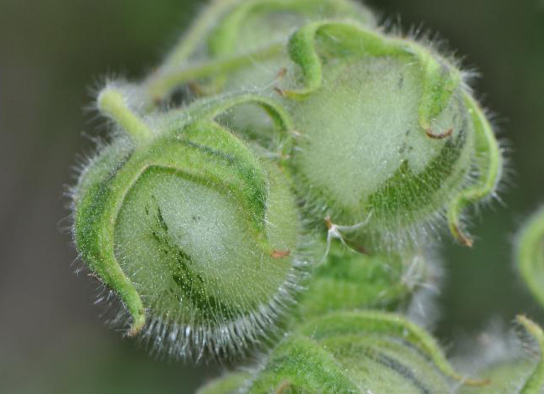
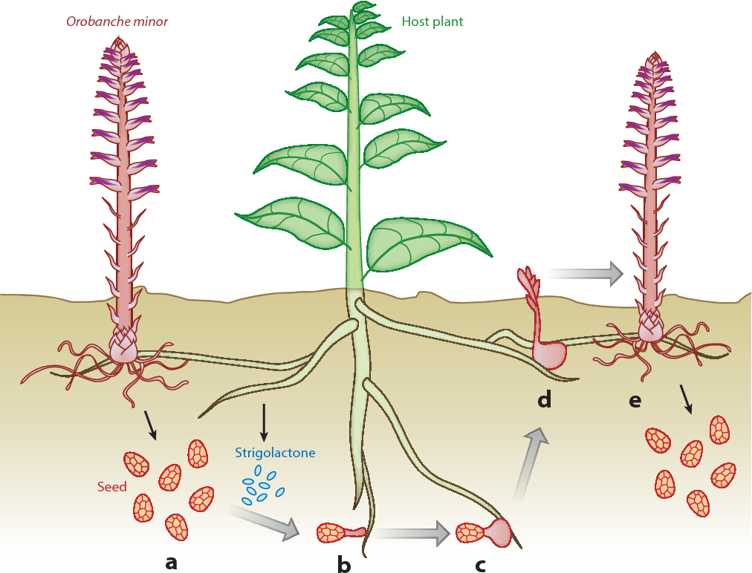
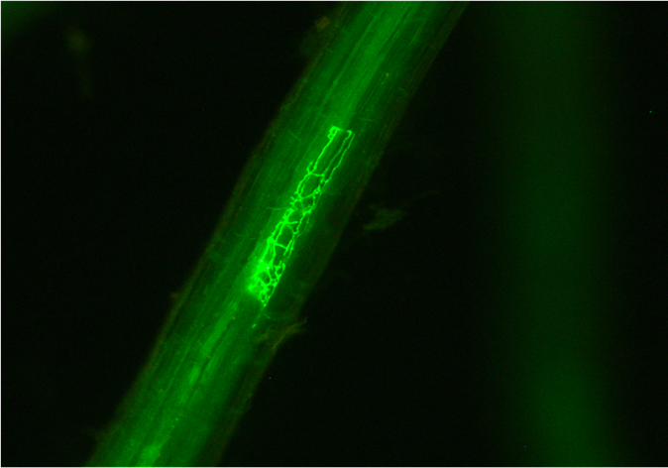
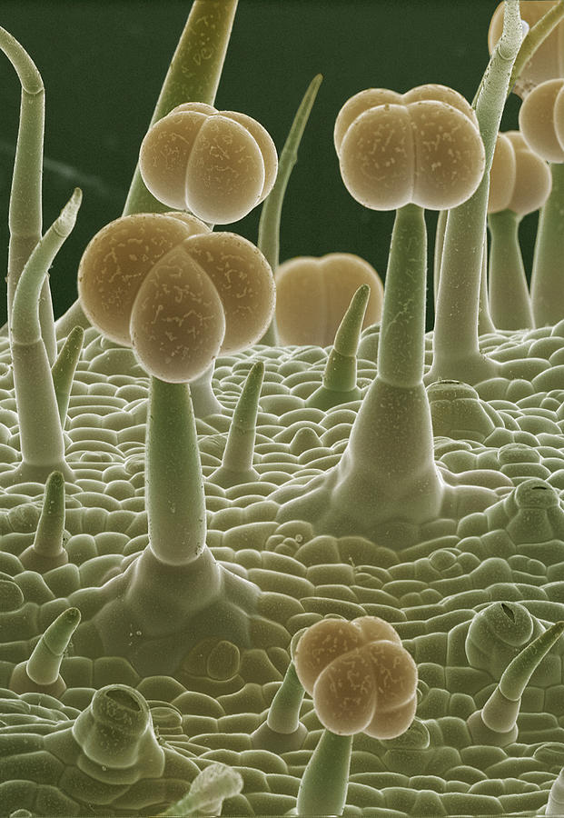
“Give me a gene to work with” My work related to ML
Close collaboration with plant biologists for research projects
Identification of relevant features (genes, metabolites) related to a phenotype (e.g. resistance)

Slide 12
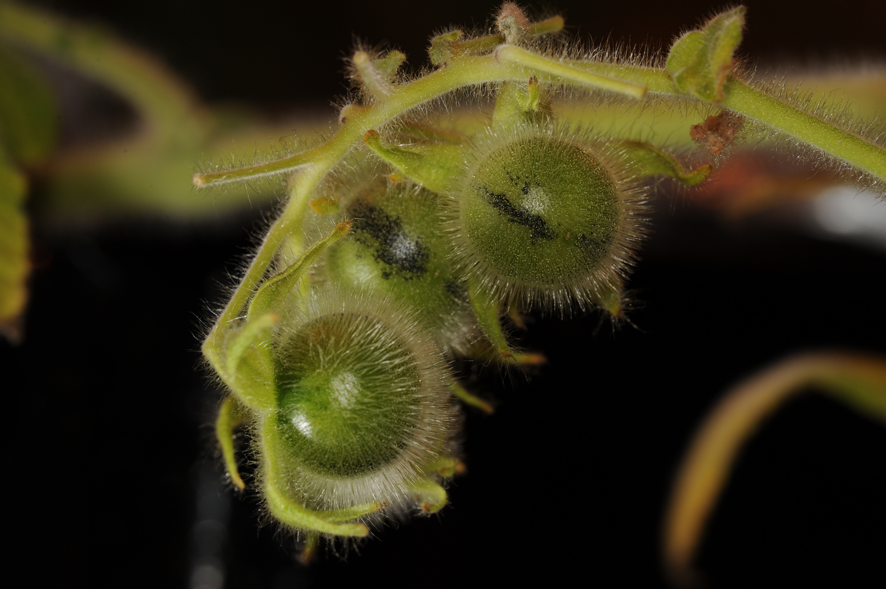
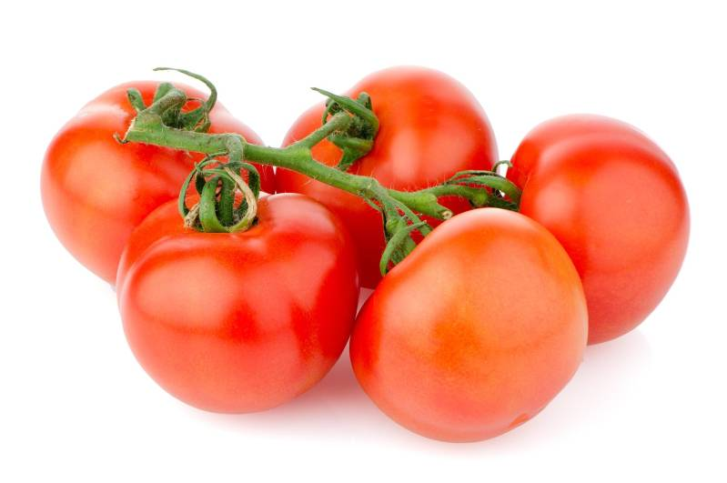
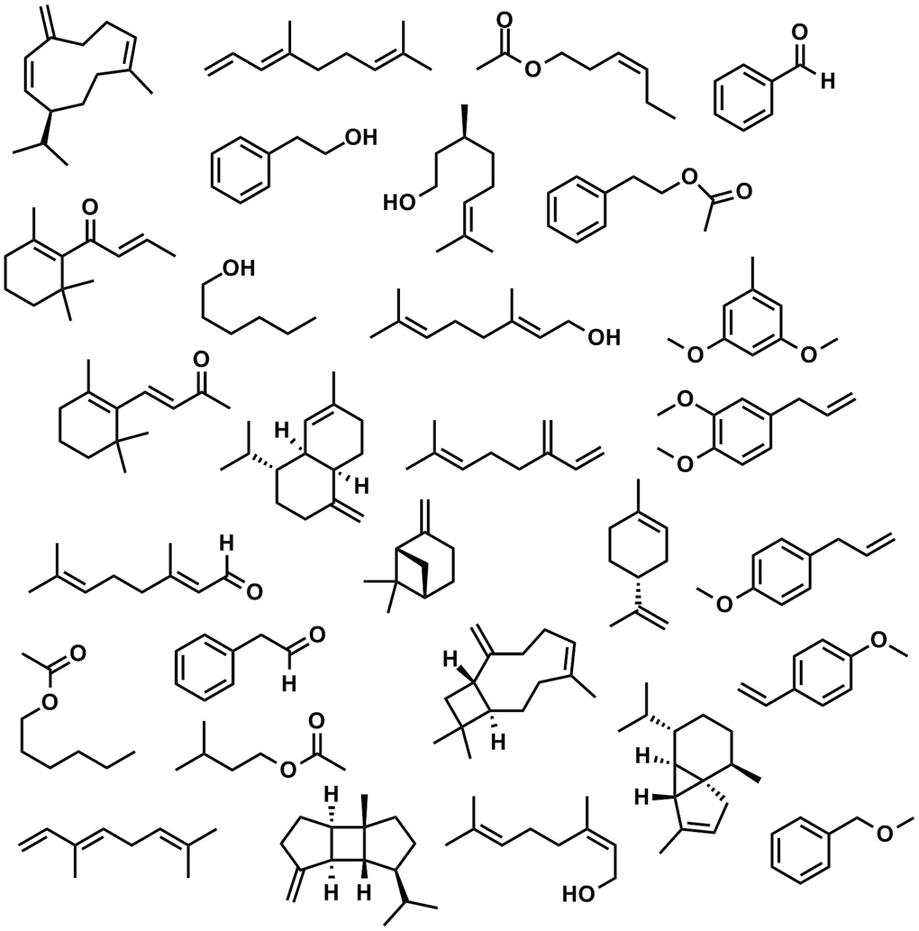

Natural insecticides from wild tomato relatives
breeding

Slide 13
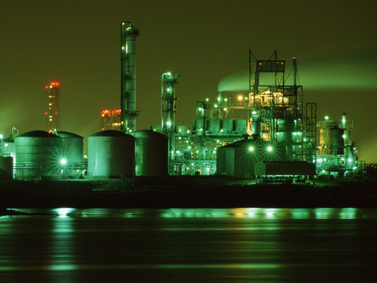
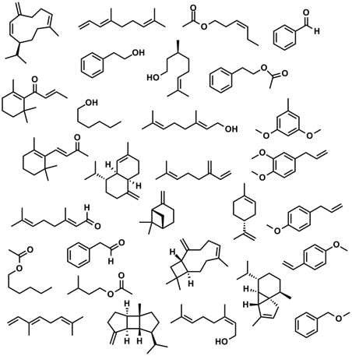
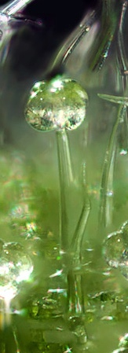
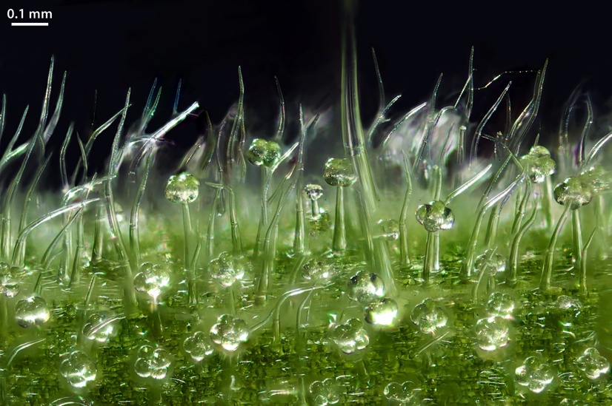

Glandular trichomes from wild tomato are small biochemical factories
7-epizingiberene
Picture: Jan van Arkel
Notes:
First: Glandular trichomes are hair-like structures on the leaf and stem surface of the plant.

Slide 14
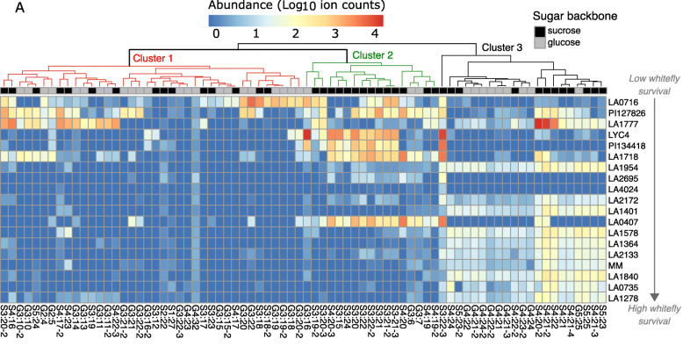
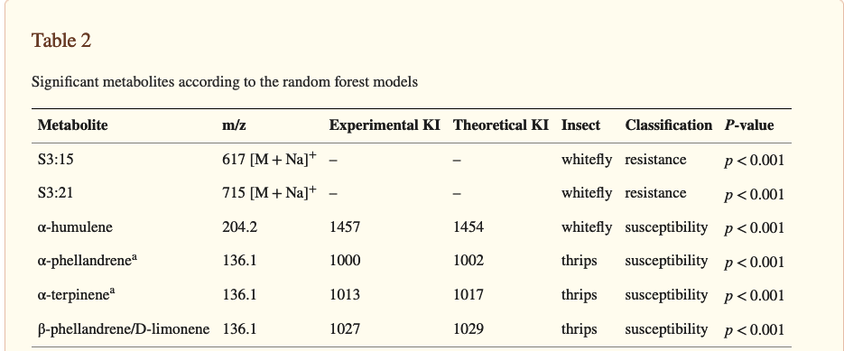
Relating metabolites to whitefly resistance ML (Random Forest) to the rescue
n = 19 tomato samples, p = 76 metabolites (acylsugars)
Kortbeek et al. (2021). BMC plant biology, 21(1), 315.

Slide 15
Can you automate ML implementation?
An introduction to AutoML

Slide 16
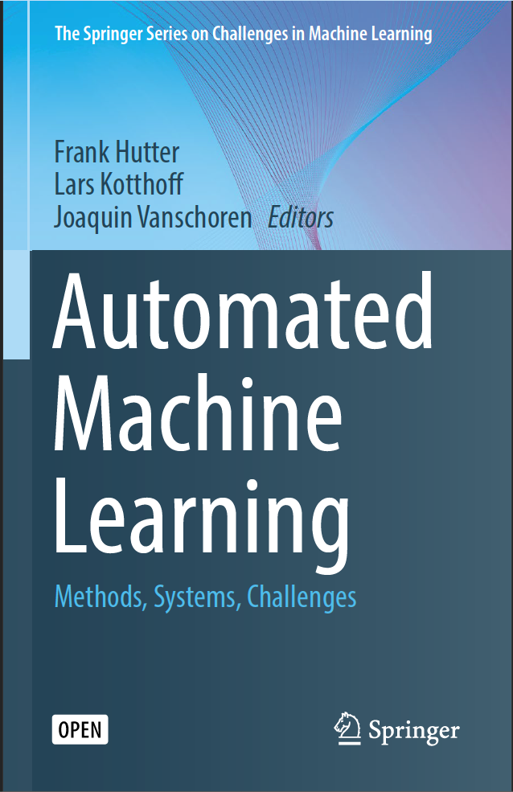
Automating ML
To-do list:
“automating data cleanup and missing data imputation”
“automating feature selection and transformation”
“automating model discovery”
“automating hyperparameter optimization”
“optimally like to automate all of it.”
Hutter, F., Kotthoff, L., Vanschoren, J. (eds) Automated Machine Learning. The Springer Series on Challenges in Machine Learning. Springer, Cham. https://doi.org/10.1007/978-3-030-05318-5_8

Slide 17
Democratization of ML
Thereby, AutoML makes state-of-the-art machine learning approaches accessible to domain scientists who are interested in applying machine learning
Hutter, F., Kotthoff, L., Vanschoren, J. (eds) Automated Machine Learning. The Springer Series on Challenges in Machine Learning. Springer, Cham. https://doi.org/10.1007/978-3-030-05318-5_8

Slide 18
Democratization of ML
Thereby, AutoML makes state-of-the-art machine learning approaches accessible to domain scientists who are interested in applying machine learning but do not have the resources to learn about the technologies behind it in detail.
Hutter, F., Kotthoff, L., Vanschoren, J. (eds) Automated Machine Learning. The Springer Series on Challenges in Machine Learning. Springer, Cham. https://doi.org/10.1007/978-3-030-05318-5_8

Slide 19


Democratization of ML
Thereby, AutoML makes state-of-the-art machine learning approaches accessible to domain scientists who are interested in applying machine learning but do not have the resources to learn about the technologies behind it in detail.
Sounds like me!
Hutter, F., Kotthoff, L., Vanschoren, J. (eds) Automated Machine Learning. The Springer Series on Challenges in Machine Learning. Springer, Cham. https://doi.org/10.1007/978-3-030-05318-5_8

Slide 20
Implementations in Python

Slide 21
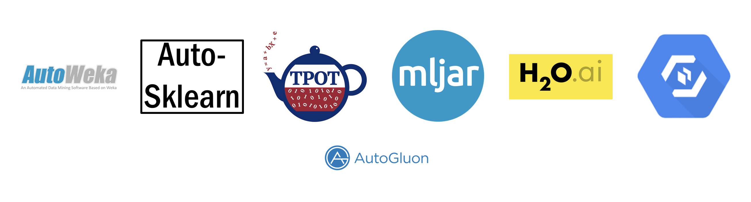
AutoML frameworks
https://mljar.com/automated-machine-learning/

Slide 22
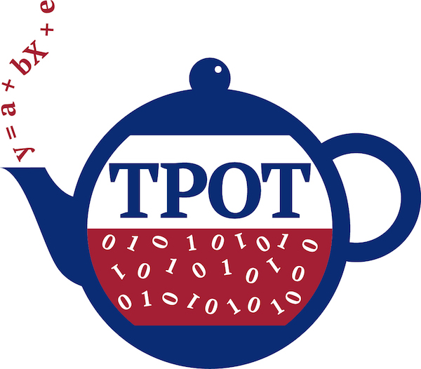
tpot optimize ML pipelines using Genetic programming
https://towardsdatascience.com/tpot-automated-machine-learning-in-python-4c063b3e5de9

Slide 23
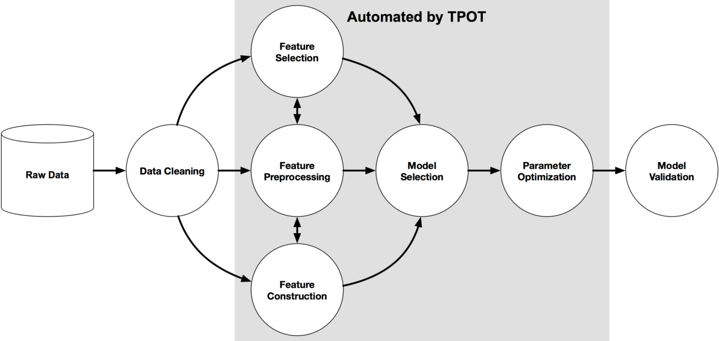
TPOT workflow
AutoML

Slide 24
Search space
Examples of models assessed for a classification problem
Naive Bayes (sklearn.naive_bayes):
GaussianNB
BernoulliNB
MultinomialNB
Tree (skearn.tree)
DecisionTreeClassifier
ExtraTreeClassifier
RandomForestClassifier
GradientBoostingClassifier.
etc.
https://github.com/EpistasisLab/tpot/blob/master/tpot/config/classifier.py

Slide 25
Search space
Examples of models assessed for a classification problem
Naive Bayes (sklearn.naive_bayes):
GaussianNB
BernoulliNB
MultinomialNB
Tree (skearn.tree)
DecisionTreeClassifier
ExtraTreeClassifier
RandomForestClassifier
GradientBoostingClassifier.
etc.
In total, for a classification problem TPOT uses:
13 classification models
14 pre-processors
5 feature selection methods
https://github.com/EpistasisLab/tpot/blob/master/tpot/config/classifier.py

Slide 26
Genetic programming algorithm
Generation 0
Generation 1
etc.
https://github.com/EpistasisLab/tpot/blob/master/tpot/config/classifier.py

Slide 27
Genetic programming algorithm
Generation 0
Generation of 100 pipelines
Generation 1
etc.
https://github.com/EpistasisLab/tpot/blob/master/tpot/config/classifier.py

Slide 28
Genetic programming algorithm
Generation 0
Generation of 100 pipelines
Evaluation of their balanced cross-validation accuracy
Generation 1
etc.
https://github.com/EpistasisLab/tpot/blob/master/tpot/config/classifier.py

Slide 29
Genetic programming algorithm
Generation 0
Generation of 100 pipelines
Evaluation of their balanced cross-validation accuracy
Selects top 20 pipelines in the population
Generation 1
etc.
https://github.com/EpistasisLab/tpot/blob/master/tpot/config/classifier.py

Slide 30
Genetic programming algorithm
Generation 0
Generation of 100 pipelines
Evaluation of their balanced cross-validation accuracy
Selects top 20 pipelines in the population
Each of the 20 pipelines generates 5 offspring = 100 pipelines
Generation 1
etc.
https://github.com/EpistasisLab/tpot/blob/master/tpot/config/classifier.py

Slide 31
Genetic programming algorithm
Generation 0
Generation of 100 pipelines
Evaluation of their balanced cross-validation accuracy
Selects top 20 pipelines in the population
Each of the 20 pipelines generates 5 offspring = 100 pipelines
5% of that offspring cross over with another offspring
Generation 1
etc.
https://github.com/EpistasisLab/tpot/blob/master/tpot/config/classifier.py

Slide 32
Genetic programming algorithm
Generation 0
Generation of 100 pipelines
Evaluation of their balanced cross-validation accuracy
Selects top 20 pipelines in the population
Each of the 20 pipelines generates 5 offspring = 100 pipelines
5% of that offspring cross over with another offspring
90% of the remaining encounter a random point mutation
Generation 1
etc.
https://github.com/EpistasisLab/tpot/blob/master/tpot/config/classifier.py

Slide 33
Genetic programming algorithm
Generation 0
Generation of 100 pipelines
Evaluation of their balanced cross-validation accuracy
Selects top 20 pipelines in the population
Each of the 20 pipelines generates 5 offspring = 100 pipelines
5% of that offspring cross over with another offspring
90% of the remaining encounter a random point mutation
Generation 1
etc.
Evaluate
Select
Crossover
Mutate
https://github.com/EpistasisLab/tpot/blob/master/tpot/config/classifier.py

Slide 34
Assets
Follows scikit-learn API:
.fit()
.score()

Slide 35
Assets
Follows scikit-learn API:
.fit()
.score()
Supports classification and regression analyses

Slide 36
Assets
Follows scikit-learn API:
.fit()
.score()
Supports classification and regression analyses
Can be executed from the command-line to gain access to more CPUs.

Slide 37
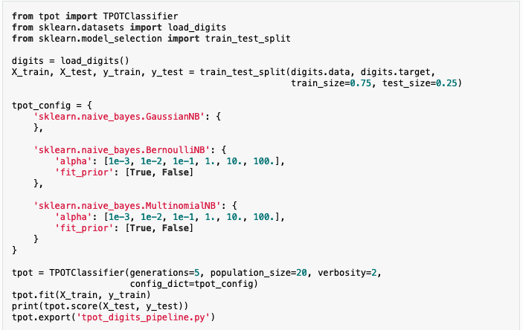
Assets
Follows scikit-learn API:
.fit()
.score()
Supports classification and regression analyses
Can be executed from the command-line to gain access to more CPUs.
Hyperparameters can be customised

Slide 38
Questions for today’s hands-on
Best model in a given time: 2min, 5min, 10min
Influence of the number of generations on final accuracy / RSME
Influence of the mutation and cross over rate on the final accuracy / RSME
https://github.com/UvA-DSC/2022-05-20_conventional-machine-learning

